Slide 1
LuxCSD clients
Client Migration Readiness
17 March 2016

Slide 2

T2S Update
Patrick Georg

Slide 3
CSG Confirmed New Migration Scenario
Decision based on recent project achievements
The CSG meeting on 02 February 2016 has confirmed the preferred new migration scenario based on recent project achievements, namely:
  Successful Migration Weekend Dress Rehearsal of Wave 3 actors on 30/31 January 2016
  Agreement on release and testing plan for Release 1.1.5 and 1.2
  Reduction of Wave 4 migration and operational risks due to Baltic CSDs switching to final wave
  Transparency about CSD migration dependencies
The Eurosystem acknowledged that some migration dependencies can only be reduced and managed but not eliminated
LuxCSD has adapted its migration plan accordingly
Remaining migration risks will be constantly and jointly monitored by T2S Board and CSG. Governing Council approval is envisaged for 17 March 2016

Slide 4
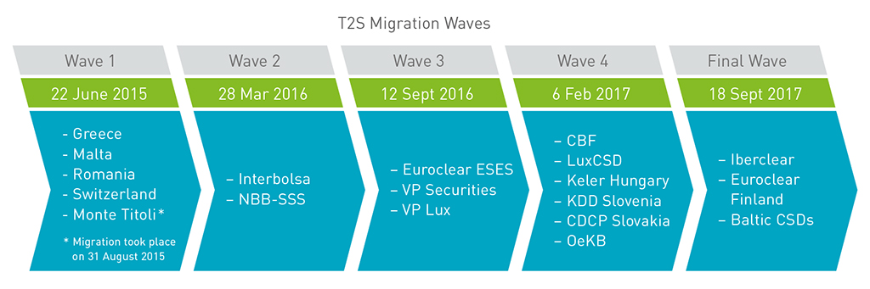
New Migration Composition and Timeline
LuxCSD new migration date: 6 February 2017
LuxCSD adapts the new migration timeline which foresees a migration on
6 February 2017
T2S Settlement Volume*
15,5%
1,1%
22,1%
37,9%
23,4%
Balanced composition of new wave 4 reduces migration risks
Strong dependency remains to a successful migration of Euroclear ESES markets in September 2016
* Source figures (2014): http://sdw.ecb.europa.eu

Slide 5
1. T2S Governance | Update
Main Scenario – Draft Planning
Overview Revised Synchronisation Points
Main Scenario
2016 |  |  |  |  |  |  |  |  |  |  |  | 2017
Q1 |  |  | Q2 |  |  | Q3 |  |  | Q4 |  |  | Q1 |  |  | Q2 |  |  | Q3 |  |  | Q4
Jan | Feb | Mar | Apr | May | Jun | Jul | Aug | Sep | Oct | Nov | Dec | Jan | Feb | Mar | Apr | May | Jun | Jul | Aug | Sep | Oct | Nov | Dec
Production
Environment
W2 Launch
W3 Launch
W4 Launch
W5 Launch
Deployments
R 1.1
W2
HF
R 1.1.5
(29/08)
W3
HF post
R 1.2
(31/10)
W4
HF pre
W4
HF post
R 1.3
all
W5
HF pre
W5
HF post
PPE
Environment
W2
W3 BD
W4
W5
Deployments
R1.1
(except CR494)
R1.1
(CR494 & 538
W2
HF
R 1.1.5
(27/06)
W3
HF pre
R 1.2
(30/09)
R 1.3
all
W4
HF post
Community
Environment
W2
W2 BD
W3 COM
W4 COM
W4 BD
W5 COM
W5 BD
Deployments
R1.1
(CR494 & 538
R 1.1.5
(16/05)
R 1.2 all
R 1.3 all
Interoperability
Environment
W4 M I/O
W5 M I/O
Deployments
R1.1
(CR494 & 538
R 1.1.5
(11/04)
R 1.2 CR 547
R 1.2 CR 526 – 533 (11/07) & 566 (25/07)
MWDR*
MWDR 2
(21-22/05)
Migration
MWDR 3
(30-31/01)
MWDR 1
(09-10/07)
MWDR 2
(01-02/10)
MWDR 3
(17-18/12)
Community
MWDR 3
(12-13/03)
MWDR 1
(16-17/04)
MWDR 3
(11-12/06)
SPs for all waves
SP9 – Start Multi. I/O
SP9.4 (25/04)
SP9.5 (11/07)
SP10 – Start Community
SP10.3 (22/02)
SP10.4 (11/07)
SP10.5 (13/03)
SP11 – Start Business Day
SP11.2 (18/01)
SP11.3 (04/07)
SP11.4 (26/12)
SP11.5 (07/08)
SP12 – End of User Testing
SP12.2 (07/03)
SP12.3 (22/08)
SP12.4 (16/01)
SP12.5 (28/08)
SP14 – Ready to Connect For Production
SP14.3 (02/05)
SP14.4 (19/09)
SP14.5 (08/05)
SP15 – Ready to Load SD
SP15.2 (04/01)
SP15.3 (13/06)
SP15.4 (31/10)
SP15.5 (26/06)
SP16 – Ready for Go Live
SP16.2 (21/03)
SP16.3 (05/09)
SP16.4 (30/01)
SP16.5 (11/09)
Community Testing
Freeze
* Migration Weekend Dress Rehearsal
Stabilisation Period
Wave Set Up
W4 Buffer
Migrated CSDs & CBs R1.2 all
Migrated CSDs & CBs 1.3 all

Slide 6
CSG Installed New CSDR Task Force
CSDs are responsible for CSDR compliance of T2S
1. T2S Governance | Update
The T2S Framework Agreement assigns responsibility for regulatory compliance to CSDs
In its meeting of 24 February, the CSG has installed a CSG Task Force in order to
  analyse the needs of CSDs for complying with the CSDR regarding T2S functionality
  establish high-level requirements in the form of change request/s to T2S
Functional enhancements are especially assumed in the area of Settlement Discipline (Art 6 and 7) and Record Keeping (Art 29)
The Task Force will be chaired by a CSD Sponsor and actively supported by the CSG Chair Office
Challenge
Compliance is required between Q2 2017 and Q2 2018
Scoping of relevant releases 1.3 and 2.0 has already started.

Slide 7

Project Approach and Key Services
Patrick Georg / Jean-Marc Schaeffer-Bonert

Slide 8
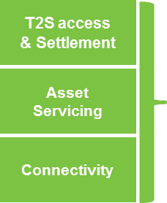
LuxCSD project approach and status
The LuxCSD T2S readiness is delivered by Clearstream. It ensures a smooth transition to T2S for its customers, based on a Staged Implementation delivering
Continuity of services and quality service level throughout adaptations to T2S
Key service elements deployed starting as of Wave 4, to allow customers to fully leverage the benefits of T2S
2016
2017
2018
Q1
Wave 2
Q2
Q3
Wave 3
Q4
Q1
Wave 4
Q2
Q3
Q4
Issuer CSD
Luxembourg (LuxCSD)
Settlement adaptations to T2S
Investor CSD¹
Investor CSD
Product & Services roll-out
6 October 2016
  ¹ Service elements roll-out plan to be announced in Q2

Slide 9
Key Service Changes Wave 4 (W4)
Positions and Account Numbers in LuxCSD
LuxCSD client accounts have presently specific 43XXX account numbers. These accounts will remain for settlement outside T2S. For the settlement in T2S, new 48XXX accounts will be used. LuxCSD clients will be requested to complete a new account application form, in order to comply with legal and compliance requirements.
The 48xxx accounts will be linked to the specific T2S security accounts, and a dedicated cash account (DCA) shall be linked respectively to the security account. The client shall provide their BIC11 (Business Identifier Code) to be used as T2S settlement party identification.
All LuxCSD issued securities denominated in EUR will be migrated to T2S in Wave 4, causing positions of LuxCSD investor accounts to be migrated to their corresponding accounts in T2S during the migration week-end of T2S Wave 4.

Slide 10
General approach for T2S Changes of LuxCSD‘s GTCs and Customer Handbook
There are no special conditions for T2S. The agreed and known GTC structure will be maintained post T2S;
The drafting style is principle-based;
“Back-to-back approach” between Eurosystem/LuxCSD framework agreement (FWA) and new LuxCSD GTCs framework;
Collective Agreement between T2S-CSDs/NCBs to harmonise finality/insolvency procedure (CA) requires minor changes to banking secrecy provisions (CA only to become effective if all participating CSDs/NCBs agree);
No operational language of T2S introduced in the GTCs to avoid need for future changes.

Slide 11
Overview of Main Areas of Change of the GTCs and the Customer Handbook (1/2)
Definitions
(Art. 1)
New definitions related to the new environment such as “Directly Connected Participant” , “Eurosystem”, “T2S Platform” , “T2S Framework Agreement “, “T2S Market”, “T2S Services” and “T2S Participating CSD“;
Banking Secrecy
(Art. 38bis)
CA requires LuxCSD to disclose reports on SF1/SF2-status of transfer orders from insolvent participants to participating CSDs/NCBs;
New draft is worded broadly to include all potential information disclosure within ordinary T2S-processing to ensure sound legal basis;
Liability
(Art. 45bis)
Adaptation of the FWA-liability regime in GTCs;
limitations of liability of LuxCSD’s liability in case of Eurosystem’s fraud, wilful misconduct, gross or ordinary negligence to a maximum total amount per calendar year equals to the fees paid for the T2S Services during a 12 month period;
Exclusion of liability for any suspension of the settlement by the Eurosystem in a currency of a non-euro area;
Finality
(Section 4.2 Customer Handbook)
Art. 21(4)(b) FWA requires CSDs to ensure the unconditionality, irrevocability and enforceability of settlement processed on the T2S platform; T2S-booking (not legacy platform) binding and enforceable;
Art. 21(4)(a) FWA (as implemented in Art. 2(1) CA) contains duty to determine moment of “SF1-finality” (Validation = moment of entry into system) and “SF2-finality” (Matching = irrevocability).

Slide 12
Overview of Main Areas of Change of the GTCs (2/2)
Principles of T2S Offering
(Art. 2)
LuxCSD to provide T2S-settlement services “as provided“ by Eurosystem, e.g. subject to disconnection and change rights of Eurosystem (Arts. 12 (3), 36 (2) FWA);
As a gateway to T2S Services, recognition of the limitation imposed by the Eurosystem and applicable to the T2S Platform
Format and connectivity
(Art. 28)
Obligation to comply with the format prescribed by the T2S Platform (back-to-back from LuxCSD duty under Art. 11 (3) FWA);
Right of technical disconnection by the Eurosystem if the technical connection represents a major threat to the security or integrity of T2S (back-to-back from LuxCSD duty under Art. 36 (1) FWA);
DCPs
(Art. 38bis)
DCPs are obliged not take any action / omission which endanger or threaten the integrity of T2S (Right of the Eurosystem towards DCPs Art. 36 (2) FWA);
DCPs are obliged to apply sufficient compliance standards for anti-money-laundering / anti-terrorist financing measures to account for direct technical relationship with T2S;
Termination
(Art. 53)
Possibility for LuxCSD to suspend or terminate the services in case the Customer, acting as DCP:
  failure to scan the instructions or to implement any relevant appropriate compliance standards for anti-money-laundering / anti-terrorist financing measures;
  failure to implement all necessary technical measures to connect its IT systems to the T2S Platform.

Slide 13
Key Service Changes W4 - LuxCSD clients
Introducing Business Features of T2S (1/2)
  The migration to T2S, will introduce both new/modified business services.
  The following overview provides a list which outlines the envisaged changes – details of each new features are covered in following slides
Partial Settlement
Bilateral Cancellation
Hold and Release of Instructions
Ex-/Cum Flag and Opt-out Indicator¹
Instruction Types (in ISO 15022)
LuxCSD
¹ These indicators are considered T2S Additional Matching Fields, and are already in use by some markets which migrated with W1

Slide 14
Key Service Changes W4 - LuxCSD clients
Introducing Business Features of T2S (2/2)
Matching Rules¹
Instructions Linking
Auto-Collateralisation²
Market Claims & Transformations²
Instruction Prioritization
LuxCSD
¹ T2S Additional / Optional Matching Fields, and are already in use by some markets which migrated with W1
² Progressive Implementation

Slide 15
Migration Approach
Stephane Van Hasselt

Slide 16
LuxCSD High Level Migration Timeline
The following time-line identifies the processing cycles of T2S, CBL/LuxCSD, and highlights the input and reconciliation steps during the migration week-end. It should be noted that client instructions will be cancelled on Friday end-of-business, with a possibility for clients to re-input their trades during the input window on Sunday February 5th.

Slide 17


Product Approach
Yves Zigrand

Slide 18
LuxCSD adopts New Technical Features of the OneClearstream Connectivity
A progressive consolidation of the portal and SWIFT/File Transfer messaging across CSDs and ICSD
Today ... T2S Go Live … Post T2S
    ClearstreamXact: a unique platform to access Clearstream's ICSD and CSD services
    Harmonised Instruction and report formats to cover all business services of CSD and ICSD (common subscription and format)
CBL and LuxCSD Connectivity
SWIFT
File transfer
(internet and VPN)
CreationOnline
Clearstream Xact
- Xact via SWIFT
- Xact via File Transfer
CBF Connectivity
- Xact Web Portal
SWIFT
File transfer and real-time
CASCADE Host/PC
    For T2S settlement activity, clients are required to use Xact, however, our existing channels remain accessible for non T2S activity
New Connectivity, simple, efficient, secure

Slide 19
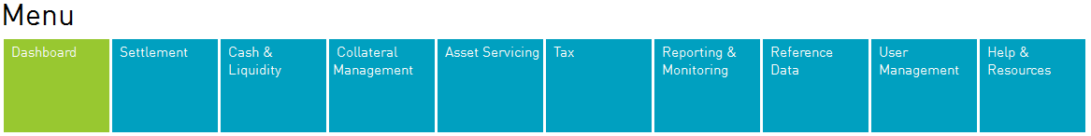
Xact Web Portal: access to all services
Single sign-on to access the full range of services
Dashboard
Settlement
Asset Servicing
Tax
Cash
Reporting & Monitoring
Reference Data
User Management
Help & Resources
Xact Web Portal
Customer
Access in one single place to all services for your activity with both the CSDs and ICSDs

Slide 20


ClearstreamXact also via Swift and File Transfer
LuxCSD will ensure the translation of customers formats to T2S
Today ... T2S Go Live … Post T2S
ISO 15022
ISO 20022
Customer
Directly connected
Customer
ISO 15022
ISO 20022
Indirectly connected
Customer
ISO 15022
ISO 15022
  Customers acting in ICP mode will provide their messages in ISO 15022.
  Customers acting in DCP mode will provide core settlement instructions in ISO 20022 to T2S.
  LuxCSD will translate ISO 15022 from customers to ISO 20022 for T2S.
  LuxCSD will also translate ISO 20022 from T2S to ISO 15022 for customers.
ISO 20022

Slide 21
Client Readiness and Testing approach
Catarina Marques

Slide 22
LuxCSD – Client Readiness¹
2016
2017
Q1
Wave 2
Q2
Q3
Wave 3
Q4
Q1
Wave 4
Q2
Q3
Q4
Set-up, Testing, and Migration Windows
Client Consultation
LuxCSD T2S information meeting for all LuxCSD clients
BIC11 and DCA set-up
Account opening²
U2A – inbound (T2S community environment)
A2A – outbound (T2S community environment)
Training (Xact test environment)
Migration (Pre/Post-Implementation)
Consultation
Middle of March
Ref Data set-up
Account Set-up
U2A
A2A
Training
Migration
T2S Test Phases
Community Test
Wave 3
Wave 4
Multilateral Test Wave 4
Migration Test Wave 4
W3 Migration Test
09+10/07 - MWDR
01+02/10 – MWDR (optional)
W4 Community Test
17+18/12 - MWDR
06/02 – Go Live W4
Multilateral Test
W4 Migration Test
  ¹ Client Readiness documentation will be gradually released to Clients starting Q1 2016
  Wave 4 Business Day Test
21
  MWDR – Migration Weekend Dress Rehearsal
Notes:
U2A – User to Application – Xact Portal (1CSR for settlement, 1CAS for asset servicing)
A2A – Application to Application (Swift, CDI)

Slide 23
Business and Technical Set-up in 5 Steps
High-Level Work-flow
For T2S settlement flows, LuxCSD clients will require the Xact Portal (replacing COL) and need to open new accounts with LuxCSD — 48xxx accounts. The 48xxx account will be linked to the specific T2S security account, which in turn is linked to a dedicated cash account (DCA)
DCA account opening with your NCB
Upon submission of the Xact Application your Portal Administrator will be requested to acknowledge receipt of the administrator keys (sent by Clearstream) in order to complete the set-up of your Xact Portal
The DCA and BIC11 are requested in the Account Opening Form
NB: for testing, a Swit test address will be required on the account opening form
Set-up of Xact portal
Completion of the Account Opening Form
In your Xact Application you will be requested to indicate the Xact Administrators
Completion of the Xact Application Form
Set-up of your 48xxx account

Slide 24
Business Elements required for
Client Account Set-up and Testing
Business Elements Required | Additional Information
Active 48xxx LuxCSD account | A duly completed and signed¹ Account Opening Application Form for ICP² will allow the set-up of your 48xxx account and BIC11
DCA account | Please indicate on the Account Opening Application Form your DCA with your NCB. This account must be in place before the Account Opening Form is submitted to LuxCSD
Active BIC11 (Bank Identification Code) | The BIC11 you will use in production must be indicated on your Account Opening Application Form. Absence of BIC11 on the form may delay the account opening procedure
BIC11 Swift addresses | Confirm your production (existing) Swift address (for instruction submission) and provide your Swift test address for testing
Holding Position for Testing Purposes | LuxCSD clients are requested to provide - at the latest by the beginning of the test phase - the list of securities (ISIN+Held-Free Balance) should they wish to consider for the test scenarios, in order to ensure balances are reported accurately. If the client has not provided a position to be used during testing, LuxCSD may choose to determine the eligible ISIN and indicate the terms of the test cases
Production/Testing
Testing

Slide 25
LuxCSD Customer Testing T2S Wave 4
Timing driven by the ECB’s overall schedule
2016
2017
JUL
AUG
SEPT
OCT
NOV
DEC
JAN
FEB
Wave 4 Launch
06.02.2017
ECB
Wave 4
MWDH
Community Test
Business Day Test
Stabili-sation
DCP Certification Testing
DCP Authorisation Testing
End Customer Testing
30.10.16
Wave 4
Client Readiness
Customer Testing

Slide 26
  Test-cases & Scenarios
Testing will be provided only for those flows / features which will change during the course of W4 implementation. For LuxCSD clients this will cover selected SWIFT inbound/outbound messages for settlement adaptations, and the usage of Xact Web Portal for U2A activities. Asset Servicing is limited in scope and will encompass REDM / INTR only.
Xact Web Portal / Swift testing - validation of inbound messages in the T2S Community Test and provision of Settlement reporting.
Settlement test cases will be limited to the ClearstreamXact products available between:
September 5 – October 30
and linked to the positions the clients have communicated to LuxCSD for testing purposes by end-of-June 2016¹
The test environment will not be available during few days end of Sep (exact dates still to be confirmed) due to the change of Swift mode, for which customers will be requested to adapt their Swift mode (2015- 2016) and submit their settlement instructions in accordance to the corresponding mode

Slide 27
Test Messages – Community Swift Testing
Settlement Inbound Messages
Settlement Outbound messages
  MT 540
  MT 541
  MT 542
  MT 543
  Settlement confirmation MT544, MT545, MT546, MT547
  Settlement status and processing advice MT548
  Settlement allegements MT578
  Statement of holdings MT535
  Statement of transactions MT536
  Statement of pending transactions MT537
  Statement of intra-position advice MT538
  Statement of allegements MT586
The status indicated in the settlement outbound messages will be provided by the T2S platform, and forwarded by LuxCSD to its clients.
  Corporate Event Notification MT 564 (REDM/INTR)
  Corporate Event Confirmation MT 566
Custody Outbound Messages – January 2017

Slide 28
Next steps
Next information session will be held second half of June
During this meeting we will present:
A detailed description of the new LuxCSD services
Test scenario’s for testing in Sep. – Oct.
By this time we also would need to receive your filled in Wave 4 Account Opening Forms in order to set up the testing

Slide 29
Back-up slides

Slide 30
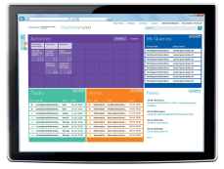
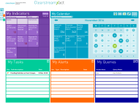

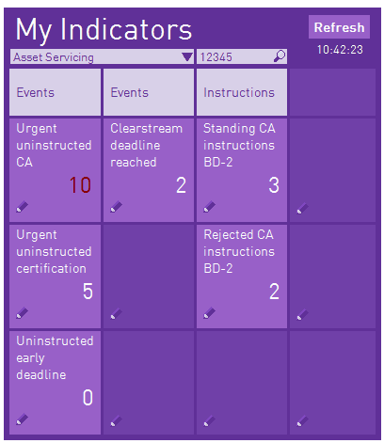

Xact Web Portal: My Indicators
All relevant quantitative information on your activity with us
“My Indicators gives real-time metrics about balances, events, instructions and currencies queries.
The panel is fully customisable so you always stay on top of the most important tasks. Clicking on the number will take you straight to the detailed information page.
- “My Indicators” will be available (via a drop-down list) for:
  Settlement,
  Asset Servicing,
  Collateral management,
  Cash & Liquidity,
  User management.
Query Item Name
Query Item count

Slide 31
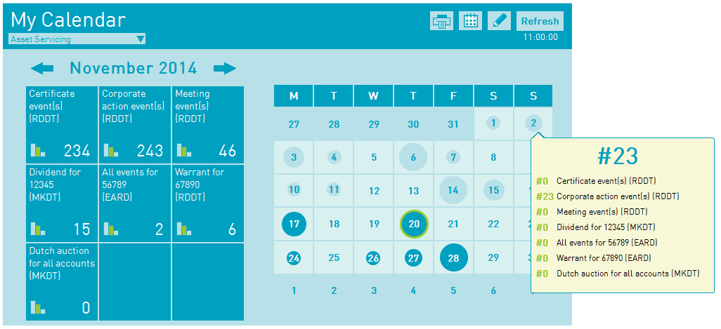
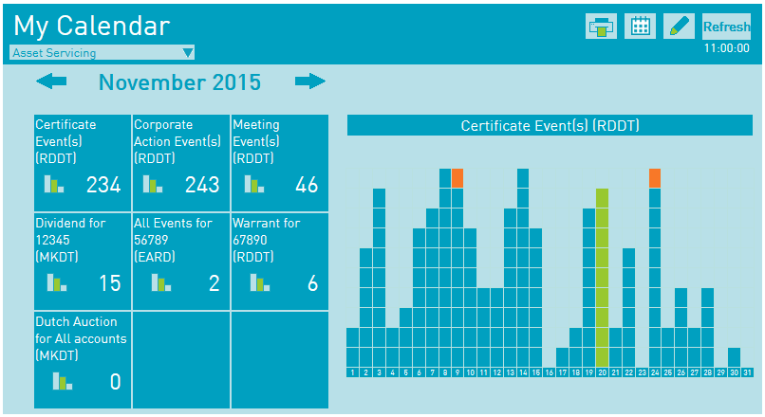
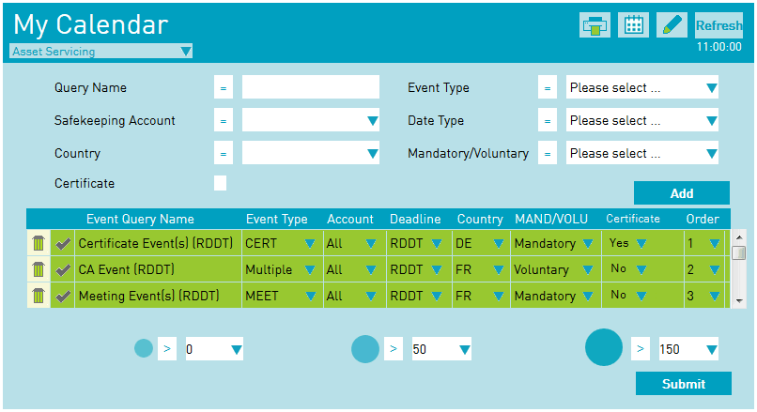
Xact Web Portal: My Calendar
Your CA, Income, Proxy Voting, Tax certificates events forecast in different configurable views
“My calendar” will provide an overview of the number of events per day that will occur during a specific month.
The information will be available via calendar and graphical views.
You will be able to configure and set up your own queries.
“My calendar” will allow you to anticipate your upcoming workload and to follow the events based on your specific business priorities (e.g. all events for a specific account, Dutch auctions for all accounts…)

Slide 32
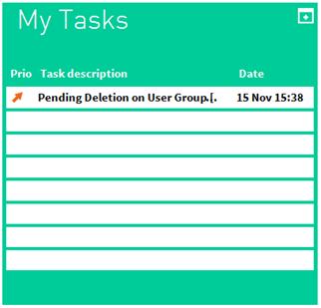
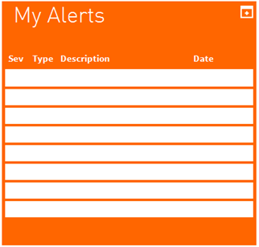
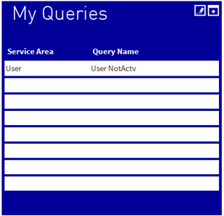
Xact Web Portal: My Tasks, My Alerts, My Queries
Your (urgent) ¨to do list¨ across ICSD and CSDs
- My Tasks is a highly customisable workflow engine to help you to manage your internal approvals process (e.g. ‘’I need to authorize a CA instruction’’).
- All Users will have access to My Alerts. It will allow to see alerts generated by the Business Monitoring Centre, and alerts generated by others services (User Management, Asset Servicing…).
- By clicking on one of the Queries displayed, you will be redirected to the corresponding list view where the results of the query will be displayed.

Slide 33
ISO15022 Inbound Message Specifications for Settlement in T2S (MT 54x)
Instruction Linking: (block LINK)
:22F::LINK/[8c]/4!c with BEFO, AFTE, WITH
Partial settlement:
The partial settlement indicator can be provided in block SETDET via the field
22F::STCO/[8c]/4!c with the following codes: NPAR ,COEX/PARC / COEX/PARQ / PART
New codes NPAR ;PART; COEX/PARC ; COEX/PARQ ; NOMC; COEX /ADEA
Priority Indicator:
The Following values can be indicated in field :22F::PRIR//4!c (block TRADDET)
'0003' = High priority
'0004' = Normal priority
Trade Transaction Condition Indicator providing the ex/cum coupon indicators may be provided (block TRADDET) in field:
:22F::TTCO//4!c with XCPN; CCPN

Slide 34
List of message types that will be used by LuxCSD
Connectivity
Settlement message types:
ISO standard | Message function | Instruction type
 |  | RFoP | RvP | DFoP | DvP | DwP¹ | RwP¹ | PFoD^{1,2}
ISO 15022 | All (New message, Cancellation, Pre-advice) | MT540 | MT541 | MT542 | MT543 | MT543 | MT541 | MT541/ MT543
 | Transaction Processing Command | MT530
ISO 20022 | New Message | sese.023
 | Cancellation | sese.020
 | Modification | sese.030
Only available for CSD customers
Mainly used for CSD processing of CCP netting results and cash payments for Corporate Action-/Income events
33
Notes:
Delivery with Payment - delivery of cash and securities from one party to another
Payment free of delivery - exchange of cash without the delivery of securities

Slide 35
Connectivity
Settlement message types:
ISO standard | Message function | Instruction type
 |  | RFoP | RvP | DFoP | DvP | DwP¹ | RwP¹ | PFoD^{1,2}
ISO 15022 | Processing advice | MT548
 | Settlement and cancellation confirmation | MT544 | MT545 | MT546 | MT547 | MT547 | MT545 | MT545/ MT547
 | Intra-Position Advice | MT508
 | Settlement Allegement | MT578
ISO 20022 | Settlement status and processing advice | sese.024
 | Settlement confirmation | sese.025
 | SecuritiesTransactionCancellationRequestStatusAdvice | sese.027
 | Intra-Position Advice | sese.015
 | Settlement Allegement | sese.028(NEW) sese.029(REMO)
Only available for CSD customers
Mainly used for CSD processing of CCP netting results and cash payments for Corporate Action-/Income events
34
Notes:
Delivery with Payment - delivery of cash and securities from one party to another
Payment free of delivery - exchange of cash without the delivery of securities

Slide 36
Issues reported during Italian Migration
Lessons learnt – AFME & ICMA report
1. T2S Governance | Update
Paper published by AFME with ICMA input outlines various issues encountered by their members during the migration of the Italian market to the T2S platform
Document provides good insight with regards to the shortcomings appeared after Monte Titoli migration to T2S; this could help all participants (future wave CSDs, T2S team & clients) understand the experienced challenges and find solutions ahead
Although majority of wave 1 migration was a success, all participants should be ready for coping challenges of similar nature like the ones stated here
Main challenges had to do with failure in instructions matching, long settlement cycles than initially expected, malfunction of auto collateralisation resulting to increased liquidity needs from participants
Further issues with respect to testing cycles, repo matching and settlement rates were reported
- Follow up with AFME representative agreed to discuss findings of the paper

Slide 37
Issues reported during Italian migration (2)
Lessons learnt – AFME & ICMA report
1. T2S Governance | Update
Area of Concern | Specific Issues | Proposed Actions | Owner
Standard Settlement Instructions & Matching Issue | Late realisation by end users that static data changes needed thus leaving very little response time which resulted to many unmatched trades | SI format needs to be analyzed and publish requirements three months before going live; greater clarity required from markets about matching criteria | Markets
Settlement Issues not related to SSI (lack of matched status instructions) | ICPs did not receive status for some time after the trade was instructed; clients were unaware of their trade status and could not predict settlement and required funding ; CCPs applied settlement fines under Short Selling Regulation as a result of this gridlock; Large fixed income trades took longer to settle causing shortage of liquidity Cash and repo trades were allocated an incorrect accrued interest and settlement counter values were not as expected; | Rigorous testing required from future wave CSDs to avoid replication of the matched status; CCPs and local Markets Authorities to consider suspension of Short Selling Regime during migration wave; Re-introduction of the shaping functionality by CCPs or CSDs in the overnight cycle would increase bond liquidity; CSDs to check that test cases include and check all types of instrument; | CSDs CCPs & Local Markets Authorities CCPs & CSDs CSDs

Slide 38
Issues reported during Italian migration (3)
Lessons learnt – AFME & ICMA report
1. T2S Governance | Update
Area of Concern | Specific Issues | Proposed Actions | Owner
Settlement Issues not related to SSI (lack of matched status instructions) | Autocollateralisation did not work as expected, as a result CCPs injected significant liquidity to the system; Delays in cross border settlements. Cross border instruction processing took more than the agreed time of five minutes; | DCPs and custodians to confirm this functionality is tested, liqudity requirements to be reviewed during testing; CSDs to highlight main changes from current state to future state to their participants and T2S team to assure the markets that this functionality is fully operational for all members; CSDs´ clients should receive status updates on a regular basis on that item | DCPs & CSDs CSDs clients

